Slide 1
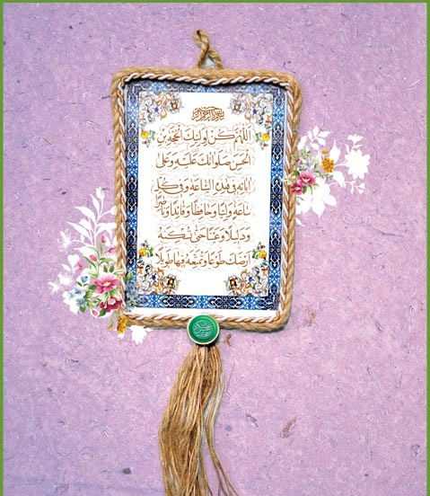
Becoming a perfect human being
انسان کامل و رسیدن به کمال
Lesson 6
Self-Building
خودسازی

Slide 2
Becoming a perfect human being
انسان کامل و رسیدن به کمال
Purification
تزکیه
Self-Building
خودسازی
Elevating to higher ranks
ارتقاء
Self Recognition
معرفة النفس
Self Cleansing
تخلیة النفس
Self Refinement
تهذیب النفس
Self Maintenance
جلاء النفس

Slide 3
Self-Building (خودسازی)
Action Item:1
1. Recognition of duties (شناخت و معرفت)
    Rituals of worship (احکام تعبّدیات)
    (The only way is to use the Risalah of your Mujtahid)
    Non-religious Rituals (احکام غیر تعبّدیات)
    (A’ql, Qur’an, Hadith, Islamic Books, Law of the Land, experience, traditions, etc…)
    Etiquette, ethics and morals (اخلاق)
    (Books of Akhlaq), visits to graveyard, spending time with wise person.

Slide 4
Self-Building (خودسازی)
Action Item: 2
2. Its obligatory for all of us to learn the Islamic laws
which we need in our daily life such as prayer, fasting,
hajj, business laws, family, children upbringing,
divine rights, etc.

Slide 5
Self-Building (خودسازی)
Action Item: 3 (النظم فی الامور)
3. Maintain, organizing and balance our lives in three major parts.
A. Seeking personal growth – More than 1/3 of day
1. Spiritual Maintenance ((العبادات
2. Refreshment and entertainment (الاستراحه و النوم)
3. Body maintenance (Food, exercise, etc)
4. Upgrading ourselves (Seeking knowledge, awareness, etc.)

Slide 6
Self-Building (خودسازی)
B. Seeking means of livelihood (studies, work, seeking jobs, etc.) – 1/3 of time
C. Maintaining relationship between us and people
1. Family (husband/wife, children, parents, relatives)
2. Friends & Neighbors
3. Social life

